Slide 1
RESEARCH PROJECT REPORT IN FULFILMENT OF SUMMER INTERNSHIP PROJECT
TOPIC:
INTERNATIONAL ORGANIZATIONAL FOR
STANDARDIZATION(ISO)
SUBMITTED BY: SUBMITTED TO:
Saniya Usmani Shashwat Singhal

Slide 2

Introduction to ISO
ISO stands for International Organization for Standardization.
It is an independent, non-governmental international organization.
Established in 1947.
Headquarters: Geneva.
Develops international standards to ensure quality, safety, and efficiency.

Slide 3

Objectives of ISO
Improve product and service quality.
Promote international trade.
Ensure customer satisfaction.
Enhance safety and reliability.
Encourage innovation and sustainability.

Slide 4

ISO 9001
Purpose: Quality Management System (QMS)
Explanation:
ISO 9001 helps organizations consistently provide products and services that meet customer and regulatory requirements. It focuses on customer satisfaction, continuous improvement, and efficient business processes.
Example: A manufacturing company uses ISO 9001 to improve product quality and reduce defects.

Slide 5
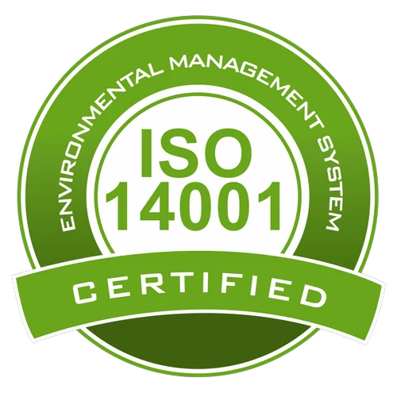
ISO 14001
Purpose: Environmental Management System (EMS)
Explanation:
ISO 14001 helps organizations reduce their environmental impact by managing waste, conserving resources, preventing pollution, and complying with environmental regulations.
Example: A factory implements ISO 14001 to reduce emissions and recycle waste materials.

Slide 6
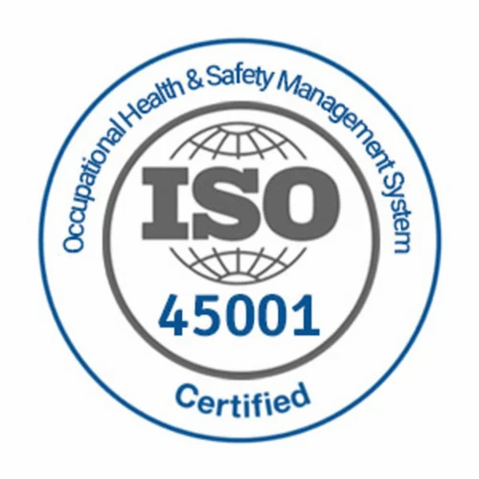
ISO 45001
Purpose: Occupational Health and Safety (OH&S)
Explanation:
ISO 45001 helps organizations create a safe workplace by identifying hazards, reducing workplace risks, and preventing injuries and illnesses.
Example: A construction company follows ISO 45001 to improve worker safety and reduce accidents.

Slide 7

ISO 27001
Purpose: Information Security Management System (ISMS)
Explanation:
ISO 27001 provides a framework for protecting sensitive information from unauthorized access, cyber threats, and data breaches through effective security controls.
Example: A bank uses ISO 27001 to secure customer financial information.

Slide 8

ISO 22000
Purpose: Food Safety Management
Explanation:
ISO 22000 ensures that food is safe throughout the entire supply chain by identifying and controlling food safety hazards.
Example: A food processing company uses ISO 22000 to ensure its products are safe for consumers.

Slide 9
Utility of ISO (International Organization for Standardization)
Improves Product and Service Quality
Enhances Customer Satisfaction
Increases Operational Efficiency
Facilitates International Trade
Ensures Safety.
Supports Legal and Regulatory Compliance Reduces Costs
Protects the Environment
Improves Information Security
Encourages Continuous Improvement

Slide 10

CONCLUSION
ISO standards help organizations deliver better-quality products and services, improve efficiency, increase customer trust, ensure safety, support sustainability, and compete successfully in both national and international markets.

